Slide 1
A tutorial explaining by example Tryton installation & usage for first time administrators & users of the system - Usage : Ancillaries
Tryton By Example
Github - https://github.com/clixwise/tryton-by-example Version of documentation : 01.01 Dated 28-Apr-21 Version of Tryton : 5.8 Verified for execution on : Windows 10 & Powershell 7 Documentation : GNU GPL Author : Marc Rottiers

Slide 2
Table of Contents

Slide 3
TOC
Attachment
Note
Managing attachments
Managing notes

Slide 4
Attachment

Slide 5
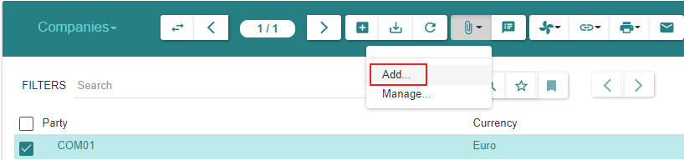
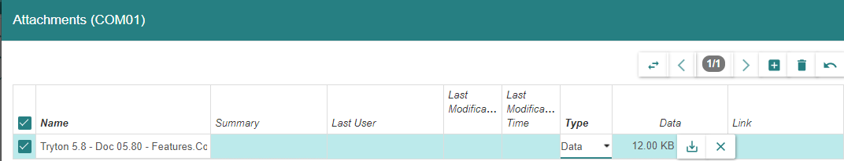
Configuration Wizard

Slide 6
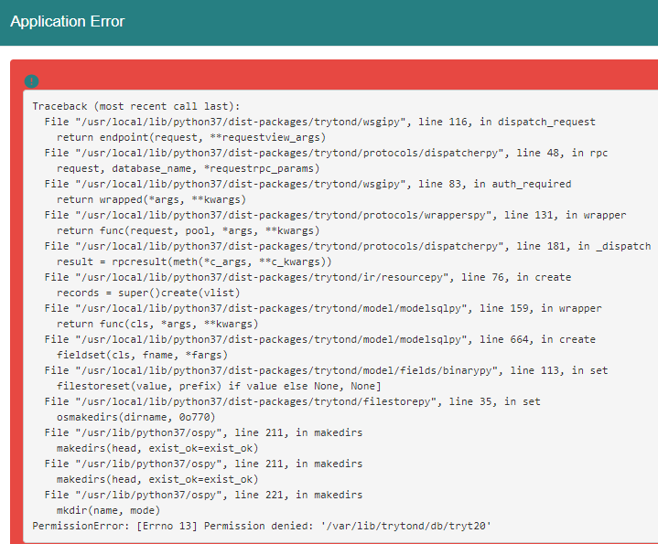
Configuration Wizard
https://bugs.tryton.org/issue1721
https://bugs.tryton.org/issue4201
https://hg.tryton.org/trytond/file/20f6cdea9808/trytond/ir/attachment.py#l148
You must give write permission to user running trytond to this directory or change the data_path in the config file.
https://bugs.tryton.org/issue59

Slide 7
Notes

Slide 8
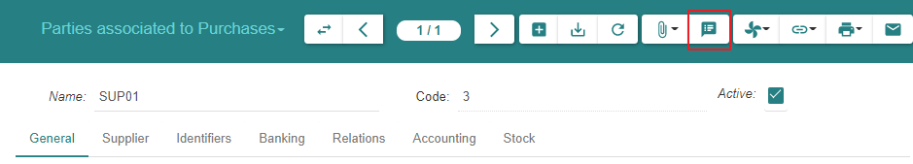
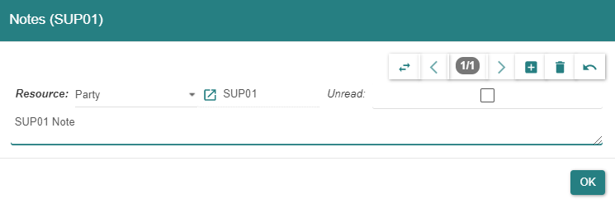
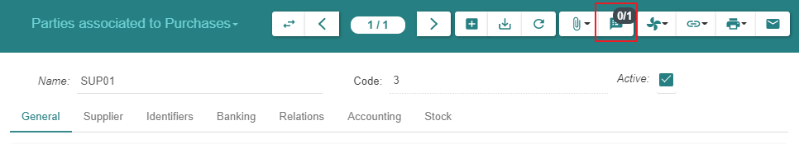
Attaching a « Note »

